Slide 1
AUSA 2016 Global Force Symposium and Exposition
15 – 17 March 2016
Von Braun Center (VBC)
Huntsville, AL
COL William Chlebowski
Maneuver, Aviation, and Soldier Division Chief
Army Capabilities Integration Center (ARCIC)
UNCLASSIFIED

Slide 2
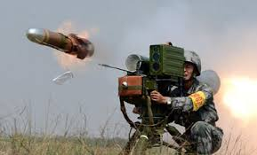
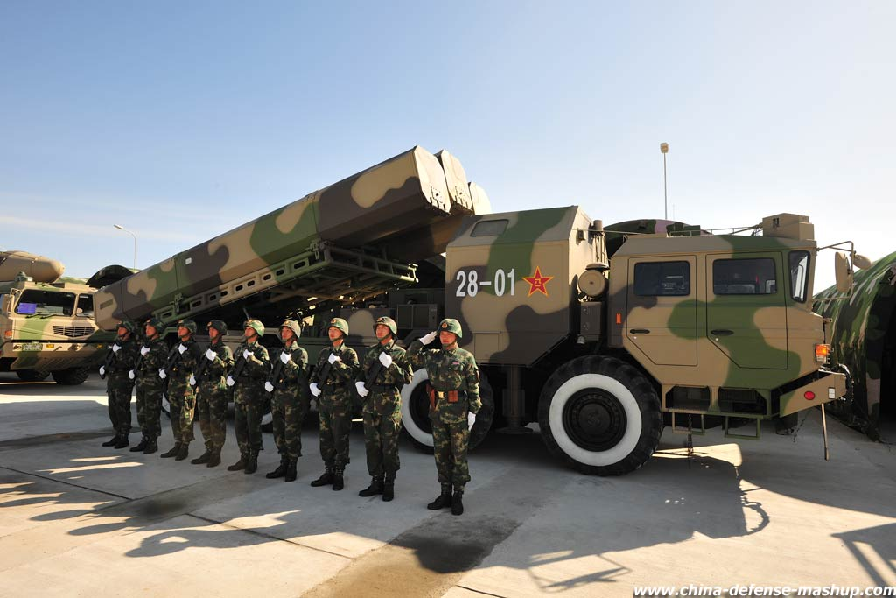
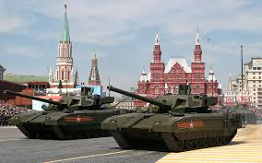
Combat Vehicle Modernization Strategy (CVMS)
Why do we need it?
Threats to Army combat vehicles are growing rapidly. Nations are modernizing conventional armored forces. Combat vehicles across the world are nearing or surpassing parity with U.S. vehicles.

Slide 3



What are the Problems?
Current Capability
IBCT: Can move quickly by strategic lift, but unable to maneuver upon arrival
SBCT: Mobile upon arrival, but lacks the lethality to exploit its mobility advantage.
ABCT: Maneuver capable, but pace of improvement lags threat evolution and tech innovation
Desired Capability
Combat Vehicles Provide required combinations of mobility, protection and lethality
Overmatch threat – Joint Combined Arms Maneuver
Strategic Deployability and Sustainability – Expeditionary Maneuver
Autonomous systems and platforms – manage risk
Capability Delta and Risk
Without IBCT maneuver capability, US forces cannot execute forcible entry under various threat scenarios
Without sufficient lethality and range, SBCTs are vulnerable to defeat by some contemporary hybrid/insurgent enemies
Without advances in vehicle protection, proliferating weapons challenge the ABCT differential advantage
Priorities
Tactical Mobility IBCT
Stryker Lethality upgrades missile/cannon
Mobile protected firepower IBCT/SBCT
Replace obsolete vehicles ABCT
Develop advanced and autonomous solutions ABCT/SBCT

Slide 4
Combat Vehicle Modernization Strategy (CVMS)
What is it?
The CVMS establishes the ends, ways and means to modernize Army combat vehicles in the near-, mid- and far- terms to meet the mobility, protection and lethality capability requirements of future Army formations.

Slide 5
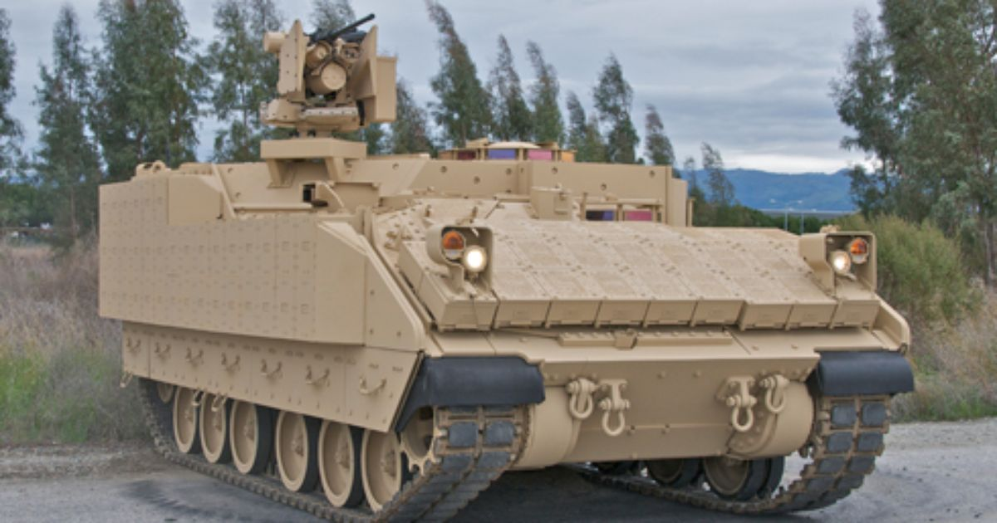
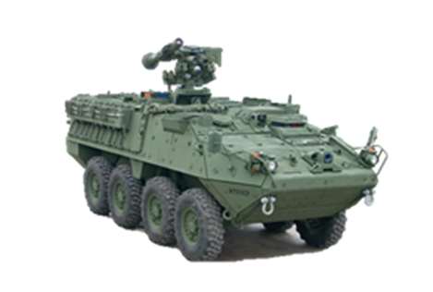
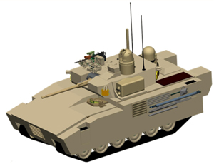
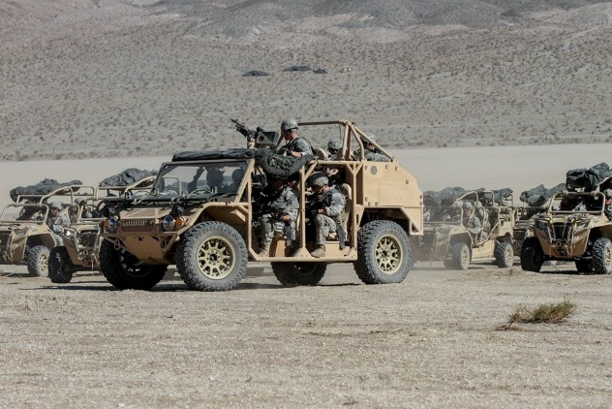
Combat Vehicle Modernization Strategy (CVMS)
What will it give us?
Combat vehicle modernization efforts must design combat vehicles to protect Soldiers against threats and deliver precision lethality, while providing both tactical mobility and global responsiveness.

Slide 6
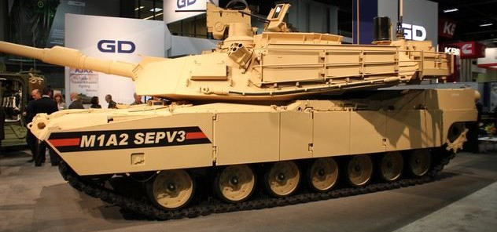
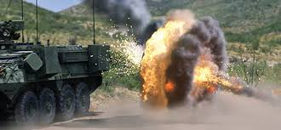
Combat Vehicle Modernization Strategy (CVMS)
How do we get it?
The Army must simultaneously pursue short-term solutions for current challenges while developing new capabilities over the mid- to long- terms to ensure overmatch in future missions.

Slide 7
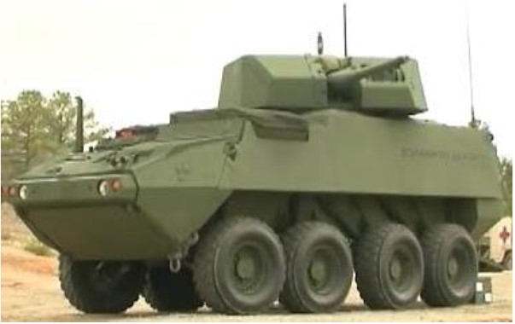
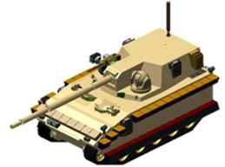
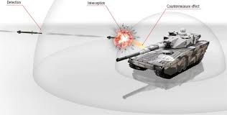
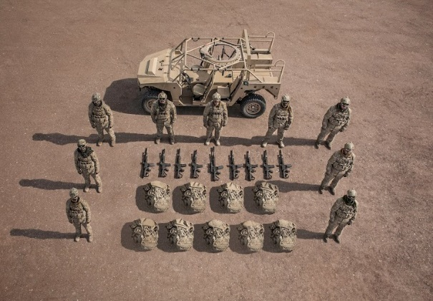
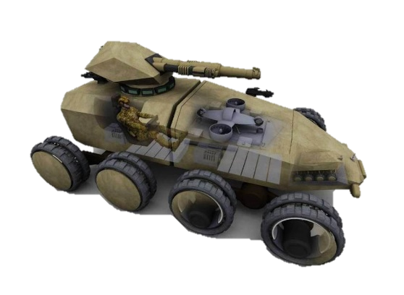
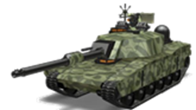
Combat Vehicle Modernization Strategy (CVMS)
When do we get it?
Timeframes:
Near | Mid | Far
2016-2021 | 2022-2031 | 2032-2046

Slide 8
Infantry Brigade Combat Team (IBCT)
CVMS IBCT Elements
Primary Systems
Ground Mobility Vehicle (GMV)
Mobile Protected Firepower (MPF)
Light Reconnaissance Vehicle (LRV)
Autonomous Technology applications
Enabling Systems
Vehicle Protection System (VPS)
Cannon Air Burst Technology
Combat Vehicle Prototyping (CVP)

Slide 9
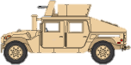
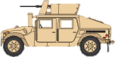
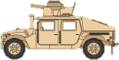
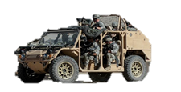

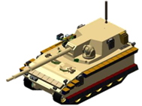


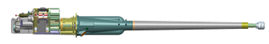

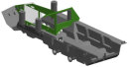
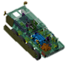
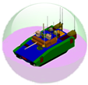
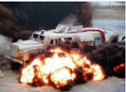
IBCT Capability Transition
Near
Mid
Far
“SIDRA”
Sustain | Improve | Develop | Replace | Assess
Current fleet | Reduction of Soldier load | New systems | Obsolete systems | Evaluate effectiveness
-IBCT -9-man Squad | -Ground Mobility Vehicle | -Light Recon Vehicle -Mobile Protected Firepower | -M1151 (HMMWV) | -JLTV as LRV -Expeditionary Maneuver
M1151A1 MK-19
M1151A1 .50 CAL
M1151A1 TOW/ITAS
Ground Mobility Vehicle (GMV)
S&T, RDECOM,
Combat Vehicle Prototyping
(CVP)
Light Reconnaissance Vehicle
(LRV)
Mobile Protected Firepower (MPF)
Commercial Off the Shelf (COTS)
Track & Suspension
Weapon Systems
Lightweight Structures
Mobile Protected Firepower (MPF)
Developmental
Architecture
Blast Migration
MAPS

Slide 10
Stryker Brigade Combat Team (SBCT)
CVMS SBCT Elements
Primary Systems
Stryker Family of Systems (FoS)
Double “V” Hull Upgrade
Stryker Mobile Gun System (MGS)
Enabling Systems
Engineer Change Proposal (ECP)
Lethality Up-Grade (Medium Caliber Cannon, Remote Weapon Station, Javelin (RWS-J))
Vehicle Protection System (VPS)
Combat Vehicle Prototyping (CVP)

Slide 11
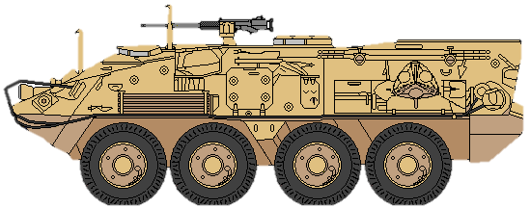
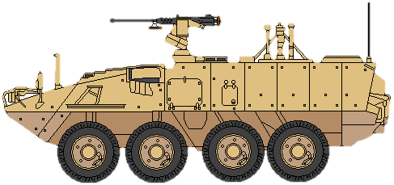
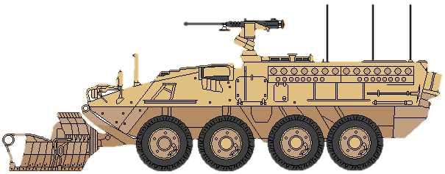
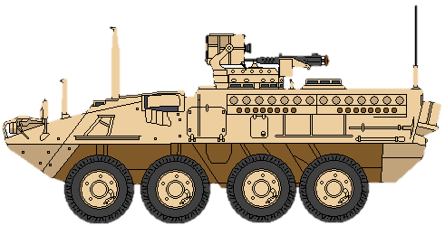
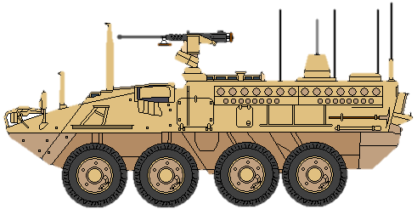
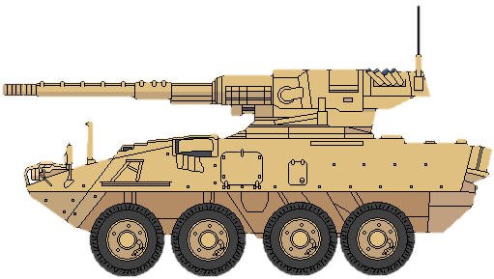
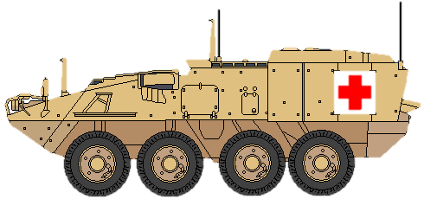
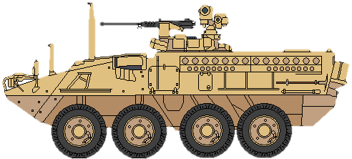
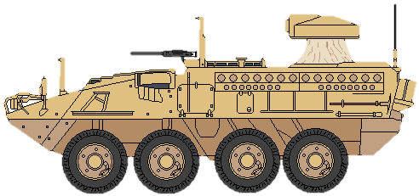
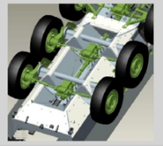
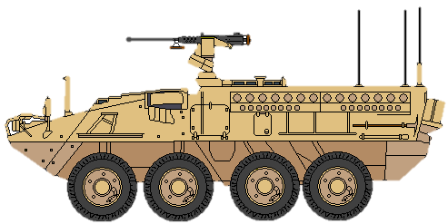
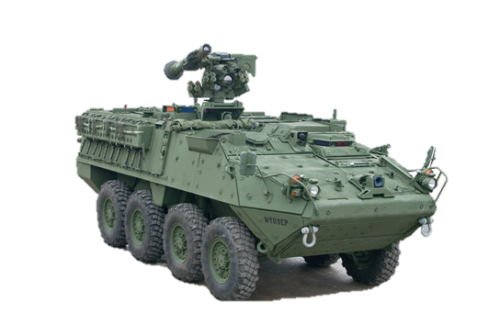
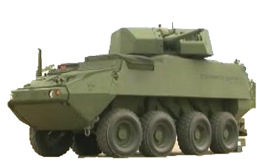

SBCT Capability Transition
Near
Mid
Far
“SIDRA”
Sustain | Improve | Develop | Replace | Assess
Current fleet ECPs | Engineer Change Proposals | New systems, Combat Vehicle Prototyping | Obsolete systems | Evaluate effectiveness
-SBCT -Fleet Recap | -Stryker DVH -Stryker Lethality | -VPS -MPF | -Flat bottom fleet | -MGS -SBCT Maneuver
M1129 Mortar
M1135 RV
M1132 ESV
M1127 RV
M1130 CV
M1128 MGS
M1133 MEV
M1131 FSV
M1134 ATGM
M1126 ICV
M1126 DVH
M1126 RWS-J
S&T, RDECOM,
Combat Vehicle Prototyping
(CVP)
M1126 30mm Cannon
Track & Suspension
Weapon Systems
Lightweight Structures
Architecture
Mobil Protected Firepower (MPF)
Blast Migration
MAPS

Slide 12
Armored Brigade Combat Team (ABCT)
CVMS ABCT Programs and Initiatives
Primary Systems
Abrams Main Battle Tank (M1A2SEP)
Bradley Family of Systems (M2A3/4)
Armored Multi-Purpose Vehicle (AMPV)
Future Fighting Vehicle (FFV)
Future Tank (FT)
Autonomous Technology applications
Enabling Systems
Engineer Change Proposals (ECP)*
Vehicle Protection System (VPS)
Medium Caliber Canon
Combat Vehicle Prototyping (CVP)
120mm Advanced Multi-Purpose Round
*An engineering change proposal is a limited improvement on a combat system that does not require development and approval of a new requirement. ECPs are limited to returning combat vehicles to the original required level of capability, but are faster and less costly than full modernization efforts.

Slide 13
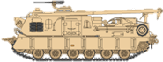
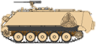
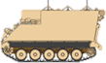
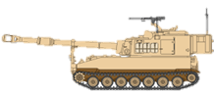
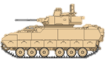
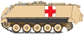
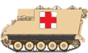
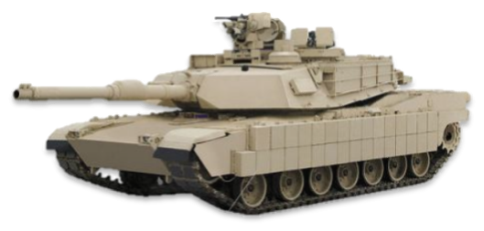
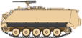
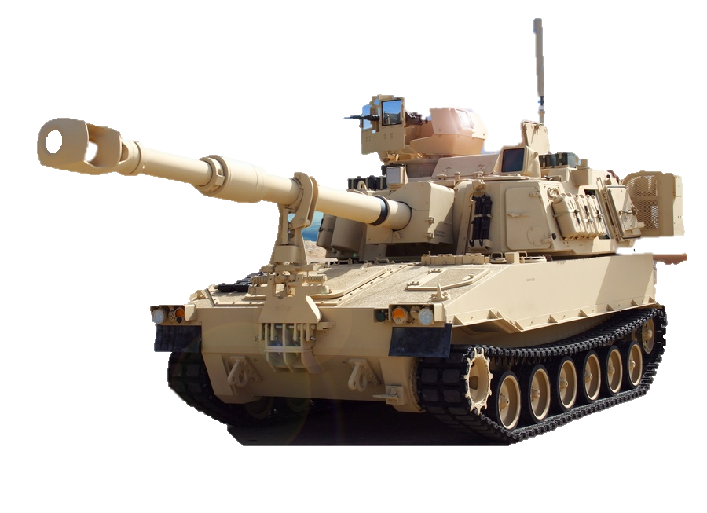
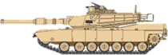
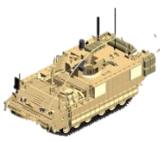









ABCT Capability Transition
Near
Mid
Far
“SIDRA”
Sustain | Improve | Develop | Replace | Assess
Current fleet (ECPs) | Technology improvements | New systems | Obsolete systems | Evaluate effectiveness
-Abrams -Bradley -Stryker -Hercules | -3rd GEN FLIR -120mm AMP -Vehicle Protection System (VPS) | -AMPV -FFV -Future Tank | -M113 | -Abrams -Bradley -Paladin -Hercules
M88A2
M113A3 Mortar
M113A3 CP
Paladin PIM
M113A3 AMB
M113A3 MT
M2A3
M113A3 GP
M1A2 SEP V3
M1A2 SEP V2
Paladin PIM
M88A2
XM 1283 GP
M2A4
AMPV FoS
XM 1284 ME
S&T, RDECOM,
Combat Vehicle Prototyping
(CVP)
XM 1285 MT
XM 1286 MC
Track & Suspension
Weapon Systems
XM 1287 Mortar
Future Fighting Vehicle
Lightweight Structures
Future Tank
Architecture
Blast Migration
MAPS
Robotic Wingman

Slide 14












Combat Vehicle Modernization
Formations possess the appropriate combination of mobility, protection and lethality to win or achieve overmatch against likely threat, under anticipated mission variables
Mobility
Protection
Lethality
Priorities
IBCT
Tactical Mobility (near)
Light recon and security capability (near)
Mobile protected firepower (near/far)
Protection and power upgrades (near)
Lethality upgrades missile, cannon (mid)
Mobile protected firepower (near/far)
SBCT
Mobility
Protection
Lethality
Replace obsolete vehicles (near)
Future Fighting Vehicle (mid)
Future tank / autonomous capabilities (far)
ABCT
Mobility
Protection
Lethality
FFV
Residual Risk

Slide 15
Back-up

